Slide 1

The Ising Model

Slide 2
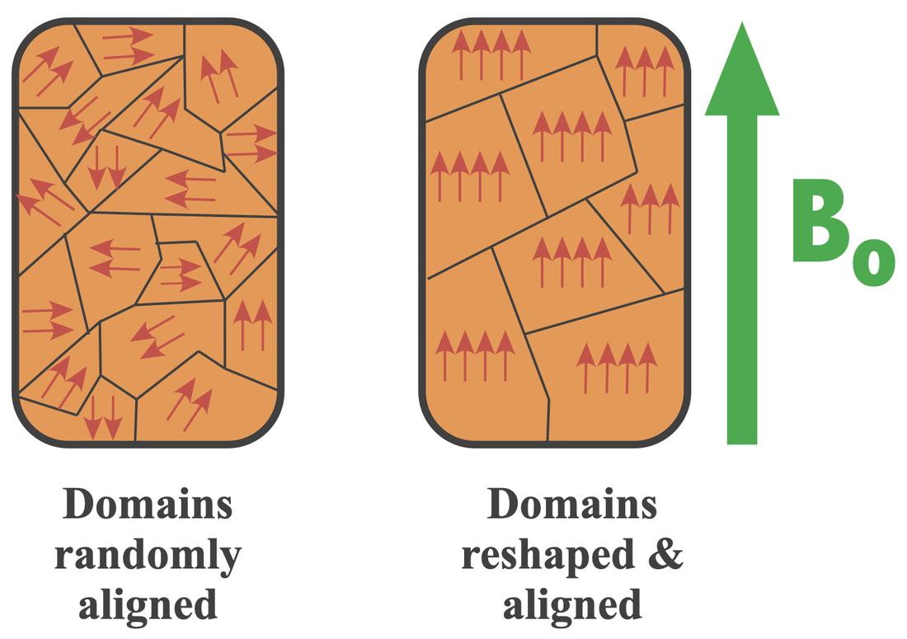

Ferromagnetism
Ferromagnetic materials exhibit spontaneous magnetization below a critical temperature $T_{c}$
Above $T_{c}$: disordered phase, $\left\langle M\right\rangle =0$
Below $T_{c}$: ferromagnetic phase, $\left\langle M\right\rangle ≠0$
Let’s try to understand these phase transitions via a lattice type model.

Slide 3
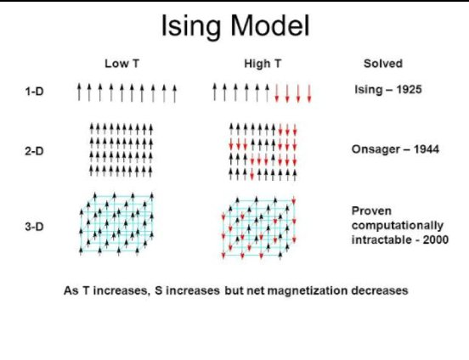

Ising Model
Models a 2D lattice of spins, $s_{i}= ±1$
Each spin interacts with its 4 nearest neighbors
The entire configuration can be described by $\left\{s_{1},s_{2}, …, s_{N}\right\}$
Hamiltonian
$$E=−J \sum_{i,j}^{N}{s_{i}s_{j}} −h\sum_{i}^{n}{s_{i}}$$

Slide 4
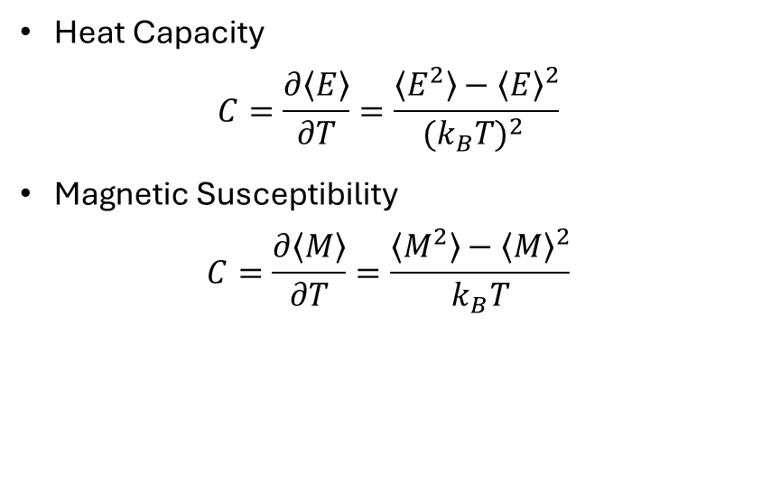

Thermodynamic Quantities
Measurements
Observables – characterizes how system responds
Magnetization measures overall alignment
$$M= \sum_{i}{s_{i}}$$
Interaction energy
$$E=−J \sum_{i,j}^{N}{s_{i}s_{j}}$$
Heat Capacity
$$C=\frac{∂\left\langle E\right\rangle }{∂T}=\frac{\left\langle E^{2}\right\rangle −{\left\langle E\right\rangle }^{2}}{{{(k}_{B}T)}^{2} }$$
Magnetic Susceptibility
$$C=\frac{∂\left\langle M\right\rangle }{∂T}=\frac{\left\langle M^{2}\right\rangle −{\left\langle M\right\rangle }^{2}}{k_{B}T}$$

Slide 5
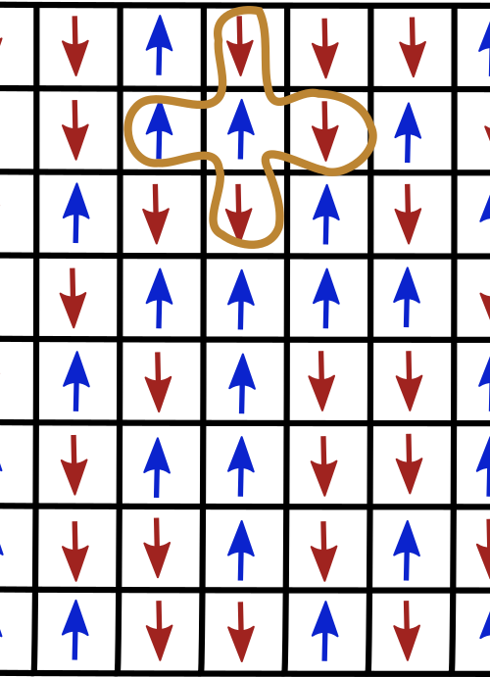

Metropolis Algorithm
Randomly select a site and propose a spin flip, changing energy,
$$ΔE=2Js_{i}\sum_{neighbors}{s_{j}}$$
Accept the flip probability
$$P= \left\{\begin{aligned}1, ΔE≤0 \\ e^{−ΔE/k_{B}T}, ΔE>0\end{aligned}\right.$$

Slide 6
Initial Conditions and Equilibrium
Common initialization gives random spins
Allow system to equilibrate before taking measurements

Slide 7
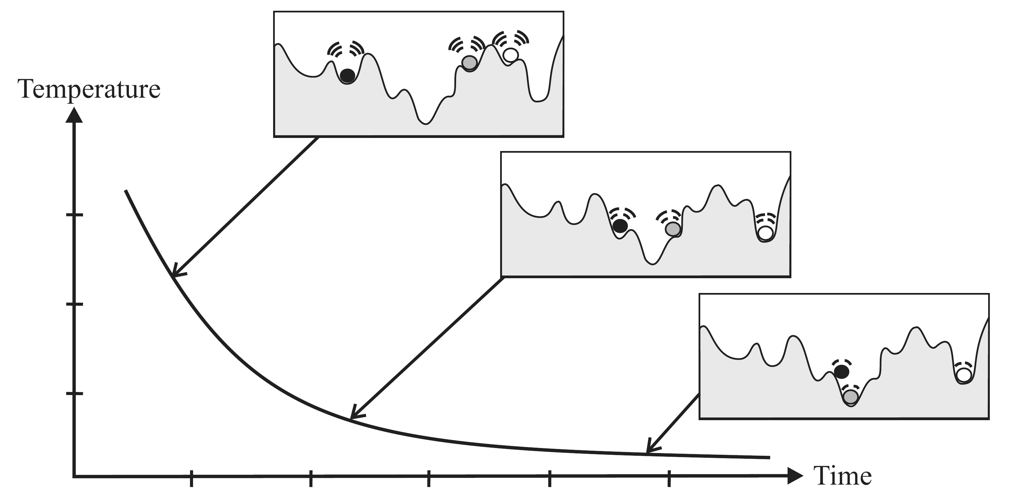
Simulated Annealing
Simulated annealing is a stochastic technique for finding low-energy configurations by mimicking the slow cooling of a physical system
Start at a high temperature
Gradually cool down the system
Use Metropolis updates at each step
Allows the system to escape local minima and settle at a near-ground state

Slide 8


Annealing Procedure
Initialize the system with random spins
Set an initial temperature $T_{start}$
Perform a Metropolis update at current $T$
Decrease $T$ using a cooling schedule
Final configuration approximates a low-energy state

Slide 9

Cooling Schedules?
Fixed Schedules
Linear:
$T_{n+1}=T_{n}−ΔT$
Exponential:
$$T_{n+1}=αT_{n}$$
Adaptive (auto-tuned) Schedules
Monitor acceptance ratio of spin flips
If too low the system becomes stuck and must cool more slowly
If too high the system doesn’t converge and must cool faster

Slide 10
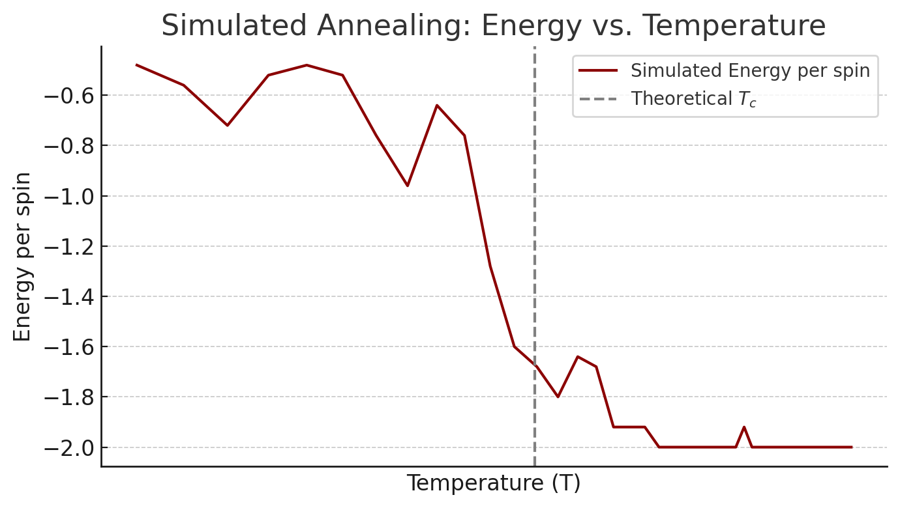
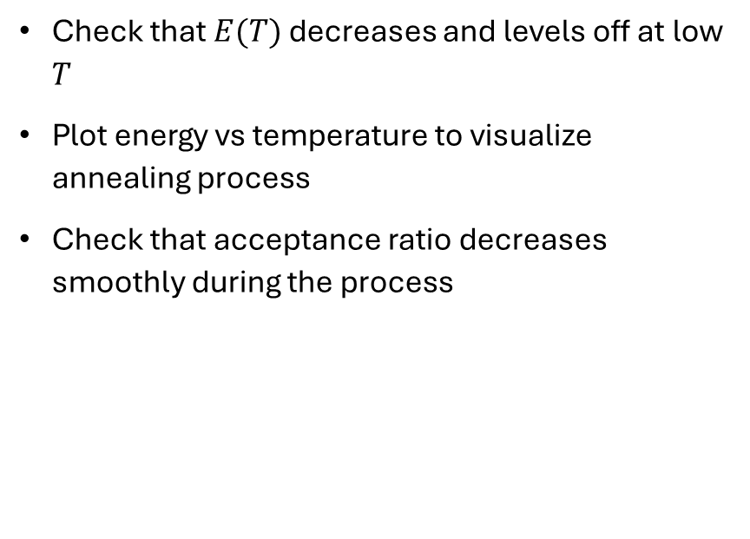
Is Annealing Working?
Check that $E(T)$ decreases and levels off at low $T$
Plot energy vs temperature to visualize annealing process
Check that acceptance ratio decreases smoothly during the process

